Slide 1
Advanced Data Mining
Model Evaluation

Slide 2
Sources for this lecture
Lantz, B. (2013). Machine learning with R. Chaps. 10 and 11 Packt Publishing Ltd.
Liu, B. (2007). Web data mining: exploring hyperlinks, contents, and usage data. Chap 3. Springer Science & Business Media.
Kuhn, M. (2008). Building predictive models in R using the caret package. Journal of Statistical Software, 28(5), 1-26.
Olson, D. L., & Delen, D. (2008). Advanced data mining techniques. Chap 9. Springer Science & Business Media.

Slide 3
Model Evaluation 101
Inherently Application specific
if you are trying to identify/predict a nasty disease you potentially have a different notion of performance than for spam detection
Uses of model evaluation:
Comparing and juxtaposing model performance
Determining the quality of a classifier
Types of data used in evaluating a model:
Actual class values
Predicted class values
Estimated probabilities of predictions
Main evaluation methods:
Hold it back, k-fold cross validation, bootstrapping.
This can be useful if two models appear the same, but one is more confident than the other, i.e. it is more accurate at estimating uncertainty. It is ideal to find a learner confident at making predictions, but timid in the face of doubt

Slide 4
Isn’t accuracy enough?
Accuracy: no. of correctly labelled instances (for a classifier)
Example: predicting a nasty, but treatable, illness
1 in every 10000 people have some disposition to the illness
if we detect this, it is treatable, if not it’s fatal
Assume our classifier always predicts no (it’s lazy and doesn’t consider the data) – it will be correct 99.99% of the time
But it’s clearly not doing what it was designed to do, and is therefore useless
This is a problem of class imbalance: when one class is (massively) more prevalent
For reasons such as this, we need other notions of performance and quality for DM and ML methods!

Slide 5
Classification / Co-incidence Matrix
 |  | True Class
 |  | Positive | Negative
Predicted Class | Positive | True Positive Count (TP) | False Positive Count (FP)
 | Negative | False Negative Count (FN) | True Negative Count (TN)
Using the values in this table we can compute most useful measures of performance
Note this is currently a two-class classification problem

Slide 6

Classification / Co-incidence Matrix Example
 |  | Actual Classification of Classes in the dataset
 |  | Class 1 | Class 2
Model Classification | Class 1 | 674 | 91
 | Class 2 | 89 | 146
 | Probability | 0.76 | 0.24
 | Accuracy | 0.88 | 0.62 | 0.82
True Positive Rate: 88%; True Negative Rate: 62%
So we are better at identifying positives than negatives
Overall accuracy: 82%
Notice a disparity in the number of TPs and TNs – we will capture this later

Slide 7
Classification / Co-incidence Matrix
Simply put:
Numbers on the diagonal from top left to bottom right are correct decisions
Everything else is an error
Using these numbers we can compute the:
True positive rate (also called hit rate, or recall): TP / (TP + FN)
False positive rate (also called false alarm rate): TN / (TN + FP)
Accuracy: (TP + TN) / (TP + TN + FP + FN)
Error Rate: 1 – accuracy or (FP + FN) / (TP + TN + FP + FN)
Precision: TP / (TP + FP)
Recall: TP / (TP + FN)
F-measure: 2 / ( (1 / Precision) + (1 / Recall) )

Slide 8

Classification / Co-incidence Matrix: multi-class
 |  | True Class
 |  | A | B | C
Predicted Class | A
 | B
 | C

Slide 9
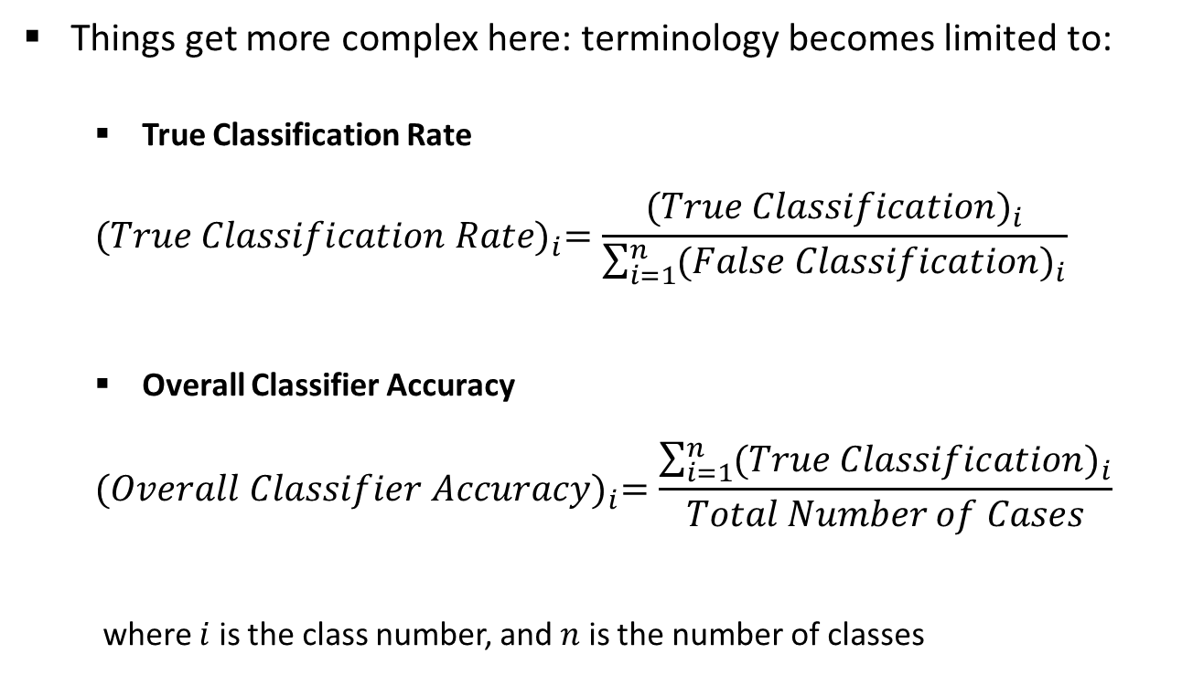
Classification / Co-incidence Matrix: multi-class
Things get more complex here: terminology becomes limited to:
True Classification Rate
$${(True Classification Rate)}_{i}=\frac{{(True Classification)}_{i}}{\sum_{i=1}^{n}{{(False Classification)}_{i}}}$$
Overall Classifier Accuracy
$${(Overall Classifier Accuracy)}_{i}=\frac{\sum_{i=1}^{n}{{(True Classification)}_{i}}}{Total Number of Cases}$$
where $i$ is the class number, and $n$ is the number of classes

Slide 10
Classification / Co-incidence Matrix: multi-class
 |  | Actual Classification of Classes in the dataset
 |  | Class 1 | Class 2 | Class 3
Model Classification | Class 1 | 22 | 7 | 2
 | Class 2 | 5 | 18 | 7
 | Class 3 | 3 | 5 | 21
 | Probability | 0.33 | 0.33 | 0.33
 | Accuracy | 0.73 | 0.60 | 0.70 | 0.68

Slide 11
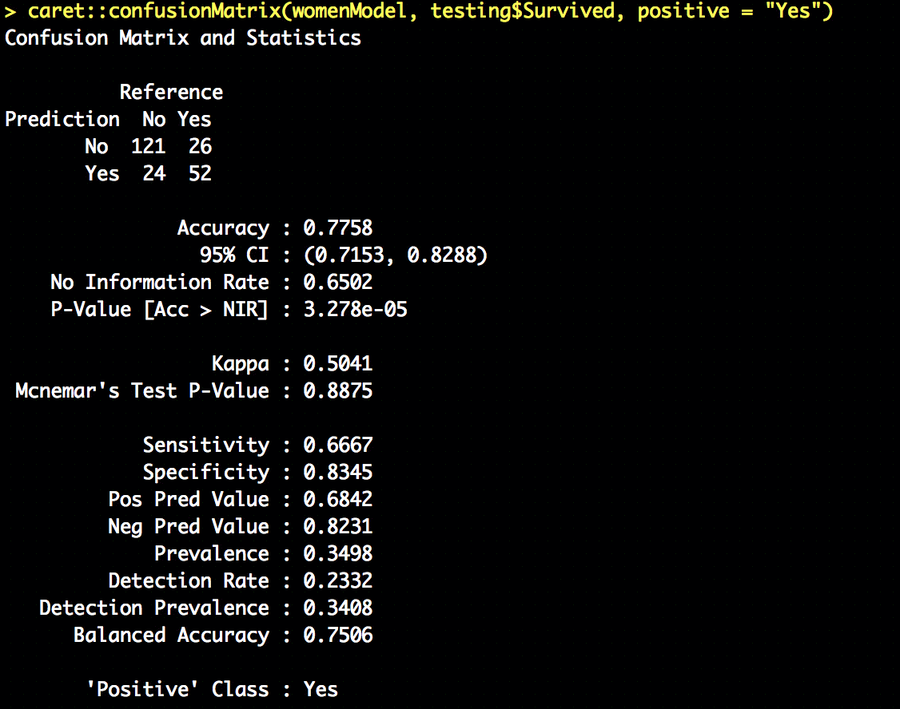
Beyond the co-incidence matrix
Adjusts accuracy by accounting for the possibility of correct prediction by chance alone
95% confidence interval
largest proportion of the observed classes
Sensitivity: the proportion of positive examples correctly classified
1-sided hypothesis test if accuracy is greater than the rate of the largest class – helpful when there are large class imbalances in the dataset
Specificity: the proportion of negative examples correctly classified
% of predicted +ves that are actually +ve (precision)
The rate of true positives also predicted to be positive
% of predicted –ves that are actually -ve
The rate of the positive class

Slide 12
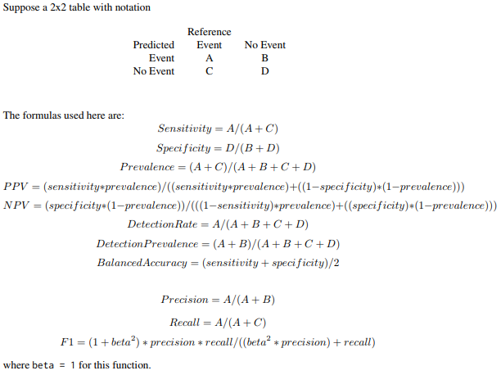
Beyond the co-incidence matrix
https://cran.r-project.org/web/packages/caret/caret.pdf

Slide 13
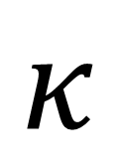
kappa statistic
$$κ$$
The kappa statistic adjusts the notion of accuracy by also accounting for the possibility that a correction prediction is chance
Kappa values are in the range [0,1]
where 1 is a “perfect” agreement between predictions and true values
1 is very rare!
A somewhat arbitrary, but common basis for evaluating Kappa values is:
Poor agreement: < 0.20
Fair agreement: 0.20 – 0.40
Moderate agreement: 0.40 – 0.60
Good agreement: 0.60 – 0.80
Very good agreement: 0.80 – 1.00
The notion of “good” agreement is also very context specific!
E.g. predicting a sports result vs. landing a shuttle safely

Slide 14
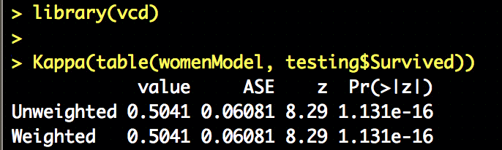
Kappa statistic
We can compute kappa without using the confusionMatrix function
Watch out for the built in Kappa function; it’s unrelated
We are interested in this example in the unweighted kappa.
Weighted is used when there are varying degrees of agreement. E.g. hot, warm, cold. Arguably warm agrees more with hot than it does cold
In a case like this where there are only two outcomes both the weighted and unweighted will be the same

Slide 15
Sensitivity and specificity
Classification is often a balance between conservative and aggressive decision making
E.g. we could eliminate all spam by also eliminating all ham
Or we could allow all ham through by not filtering spam
Sensitivity and specificity capture this trade off
Sensitivity: proportion of +ve examples correctly classified: TP / (TP + FN)
Specificity: proportion of –ve examples correctly classified: TN / (TN + FP)
Both are in the range [0,1] with 1 being desirable.
Sensitivity : 0.6667 ← 66.7% of survivors correctly classified
Specificity : 0.8345 ← 83.5% of those who did not survive correctly classified
The question is always going to be, do you prefer to be better at identifying those who survived or those that didn’t?
Finding a balance of the 2 though is very application dependent!!

Slide 16
Precision and recall
These are very closely related sensitivity and specificity; but come from the domain of information retrieval
Precision: (the positive predicted value): proportion of positive examples that are truly positive.
I.e. when you predict positive, how often you are right.
High precision means that only very likely positives are predicted as positive
Precise models are trustworthy
TP / (TP + FP)
For titanic: high precision means identifying survivors, but simultaneously ignoring the rest
Recall: how complete the results are
Basically the same as sensitivity, but with a subtle difference in interpretation
High recall means capturing a large portion of the positive examples
TP / (TP + FN)
For titanic: high recall means the majority of survivors are identified
Similar to sensitivity and specificity, most real-world problems struggle to be highly precise and have a high recall

Slide 17
In R
library(caret)
Precision:
> posPredValue(womenModel, testing$Survived, positive="Yes")
[1] 0.6842105
Recall / Sensitivity:
> sensitivity(womenModel, testing$Survived, positive="Yes")
[1] 0.6666667
Specificity:
> specificity(womenModel, testing$Survived, negative = "No")
[1] 0.8344828

Slide 18
The F-measure (or F-score)
One way to combine both precision and recall into a single measure ☺
Thus making it easier to compare models
but not necessarily address the trade off of precision vs. recall – here they are assumed to be equally important…!
We can assign weights to the F-measure, but it is hard for these to be non-arbitrary
Leverages the harmonic mean instead of the arithmetic mean in order to place higher emphasis on the positive count
F-measure = (2 * precision * recall) / (recall + precision)
= (2 * TP) / (2 * TP + FP + FN)
Instead of weighting the F-measure can use it in combination with other more globally encapsulating measures of a model’s strengths and weaknesses

Slide 19
ROC Curves
ROC: Receiver Operating Characteristics
From the days of radio transmission
A method to visually evaluate the performance of a classifier:
A 2D graph with the true positive rate on the x-axis and the false positive rate on the y-axis
4 keys points on a ROC curve:
(0, 0): classifier doesn’t do anything
(1, 1): classifier always predicts true
(0, 1): perfect classifier that never issues a false positive
Line y = x: random classification (coin toss); the standard base line
A classifier is:
better the closer it is to the point (0,1)
conservative if it is on the left hand side of the graph
liberal if they are in on the upper right of the graph

Slide 20
ROC Curve
Conservative: they make positive classifications in the presence of strong evidence, so they make fewer false positive errors;
typically at the cost of low true positive rates
Liberal: they make positive classifications with weak evidence so they classify nearly all positives correctly
typically at the cost of high false positive rates
Many real world data sets are dominated by negative instances.
Left hand side of the ROC curve is therefore more interesting
To reduce the curve to a meaningful number or scalar, we compute the area under the curve.
It is always between 0 and 1
1 is perfect, 0.5 random, and 0 should never happen

Slide 21
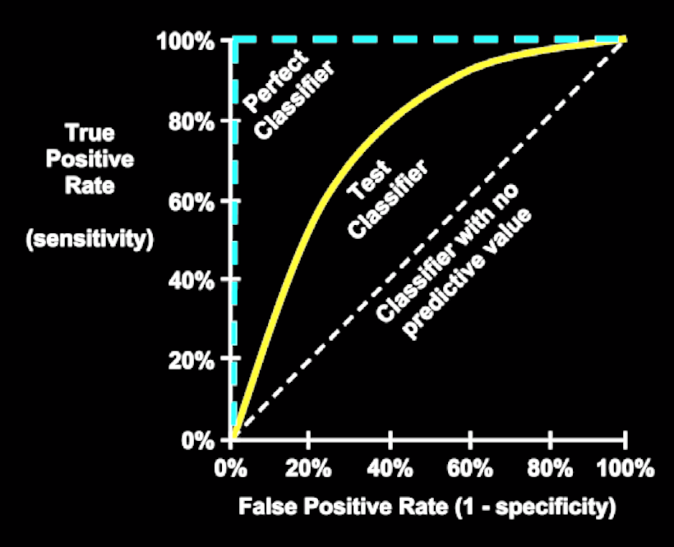
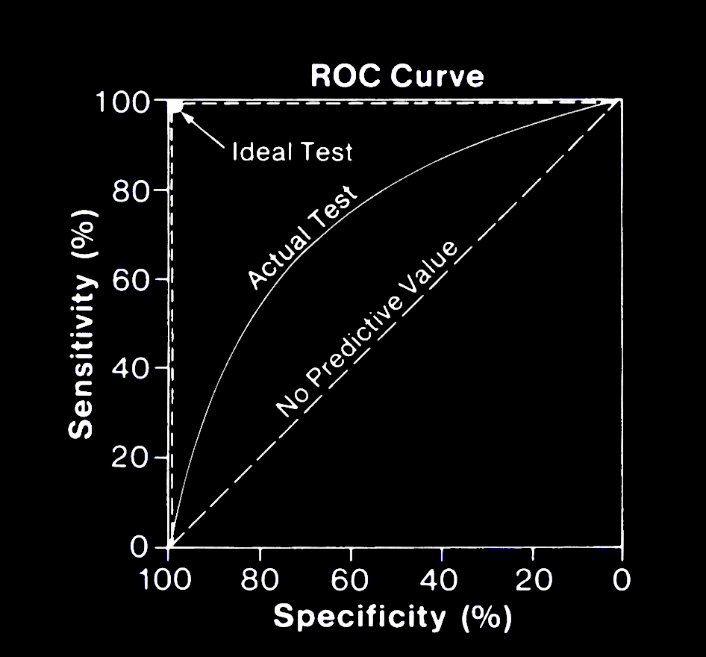
ROC Curve

Slide 22
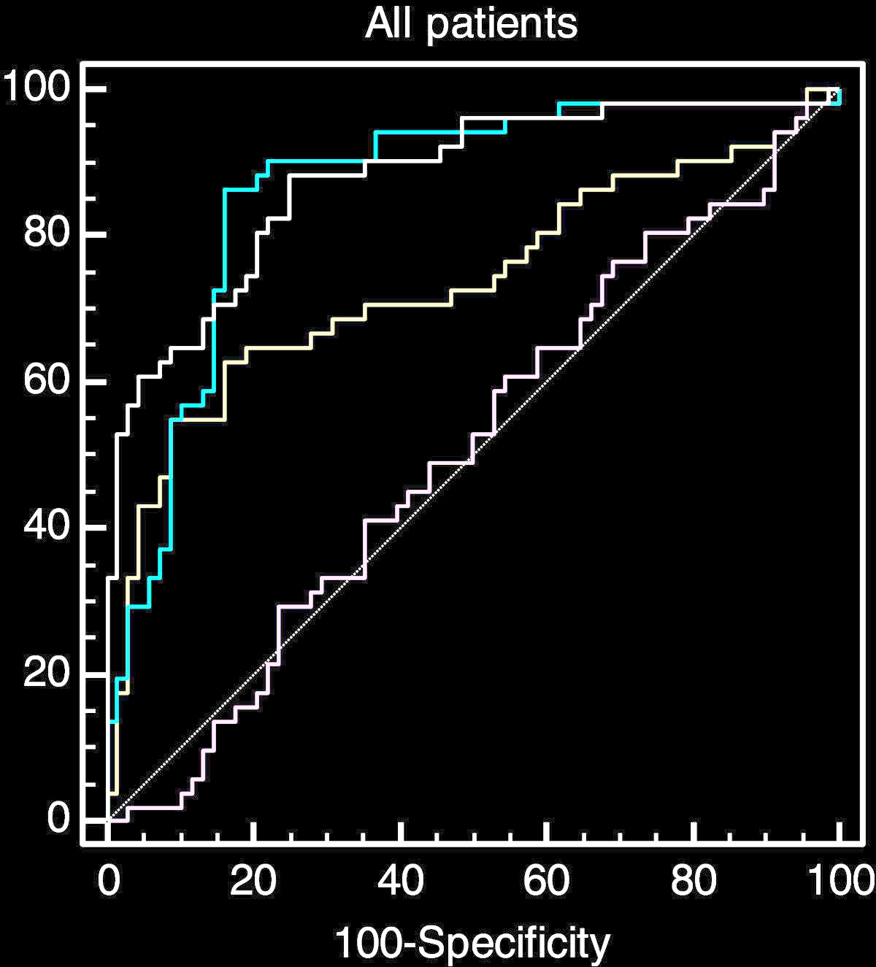
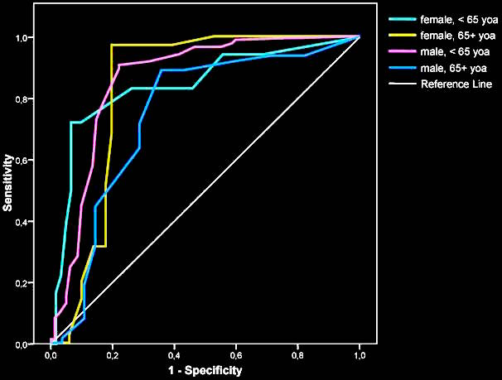
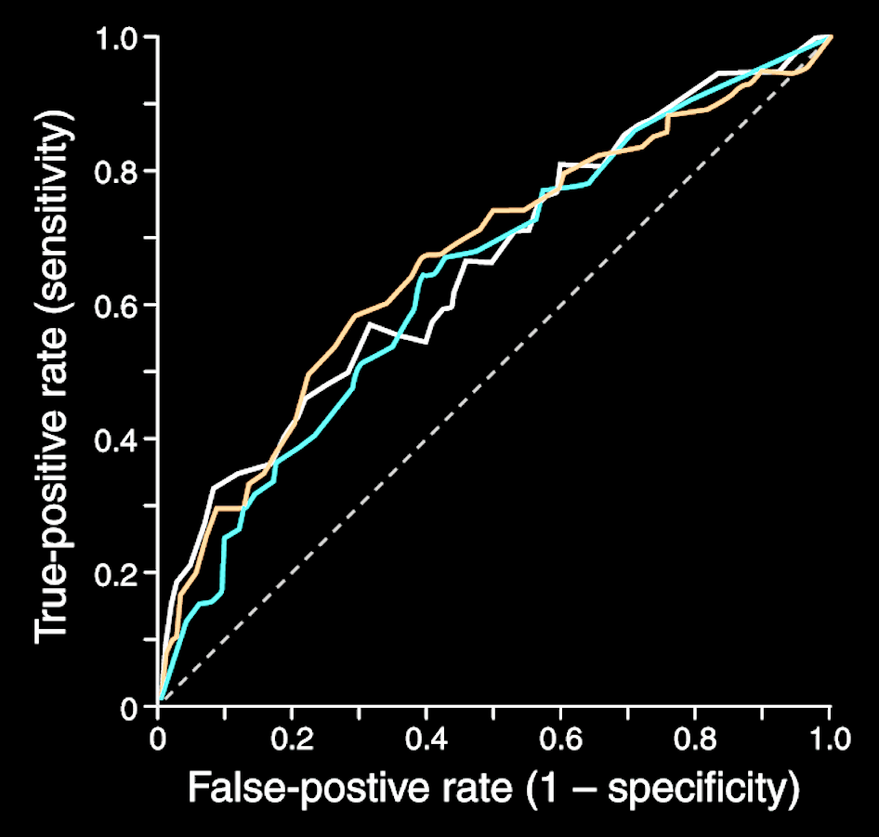
ROC Curve
To create a ROC curve we do the following:
Rank the predictions of a classifier by confidence (or probability) in (of) correct classification
Order them (highest first)
Plot each prediction’s impact on the true positive rate and false positive rate
Curves are nice, but not always easy to interpret e.g.:
So we tend to compute the area under the ROC curve instead (AUC)

Slide 23
AUC
A convention for AUC:
0.9 – 1.0 = A (outstanding)
0.8 – 0.9 = B (excellent / good)
0.7 – 0.8 = C (acceptable / fair)
0.6 – 0.7 = D (poor)
0.5 – 0.6 = F (no discrimination)
Note that ROC curves with similar AUCs may be shaped very differently so AUC can still be misleading and shouldn’t be computed without some qualitative examination of the ROC curve itself.

Slide 24
Estimating Performance
Why estimate?
We can look to predict the learner’s future performance on unseen data – thus building a confidence measure
We can determine which of potentially many options we have is best
What do we want?
Low bias
Low variance
Popular/standard approaches:
Simple Split: Holdout
k-fold cross validation
Bootstrapping
Jack-knifing

Slide 25
Simple Split (Hold out)
Portion the data set into 2 slices
Training
Testing
Build the model with the training data (commonly 75% or 80% of the data)
Test model predictions with the test data (commonly 25% or 20% of the data)
An 80/20 holdout means 80% training, 20% testing.
Although this method is nice (and simple) it assumes that the split is fair and equally representative!
Training Data
Classification Model
Preprocessed Data
Testing Data
Classification Accuracy

Slide 26
In R
Random sample:
index <- sample(1:dim(mydata)[1], dim(mydata)[1] * .75, replace=FALSE)
Stratified sample: (stratified retains the distribution of the dependent variable)
library(caret)
index <- createDataPartition(mydata$classLabel, p = 0.75, list = FALSE)
Then:
mydata_train <- mydata[index]
mydata_test <- mydata[-index]

Slide 27
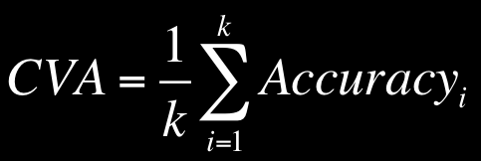
k-fold cross validation
a.k.a.: rotation estimation – the classifier is trained k times
Minimises the bias associated with one-shot random sampling by breaking the data into k mutually exclusive subsets of appropriately equal size
The model is evaluated according to the average accuracy across the k individual folds
It is important to ensure that the folds are stratified (i.e. representative of the data set as a whole) to ensure more reliable results
See: Kohavi, R. (1995). A study of cross-validation and bootstrap for accuracy estimation and model selection. In Ijcai (Vol. 14, No. 2, pp. 1137-1145).
Cross Validation Accuracy

Slide 28
k-fold cross validation
It has become common practice to set k to 10 – it tends to produce optimised results without significant compute effort
See: Breiman, L., Friedman, J., Stone, C. J., & Olshen, R. A. (1984). Classification and regression trees. CRC press.
Process:
Divide data set into k disjoint datasets of roughly equal size and ensure it is stratified
For each fold construct a classifier using all data except that of the fold data.
Test the classifier using the fold data.
Repeat 2 and 3 for all folds and compute the CVA
Interestingly, cross validation requires less data than the standard holdout approach, and tends to work well for small datasets.

Slide 29
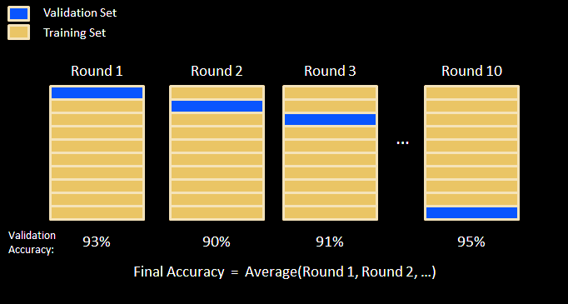
k-fold cross validation

Slide 30
In R
folds <- createFolds(mydata$classLabel, k = 10)
mydata_train_01 <- mydata[folds$Fold01, ]
mydata_test_01 <- mydata[-folds$Fold01, ]
…
mydata_train_10 <- mydata[folds$Fold10, ]
mydata_test_10 <- mydata[-folds$Fold10, ]
The solutions to lab 2, task 5, will provide an example of this in action.

Slide 31
Advanced Data Mining
Quick Overview of kNN (for the lab)

Slide 32

Nearest Neighbours explained in 60 seconds

Slide 33
Strengths and weaknesses
Strengths | Weaknesses
Simple and effective | Does not produce a model, which limits the ability to find novel insights in relationships among features
Makes no assumptions about the underlying data distribution | Slow classification phase
Fast training phase | Requires a large amount of memory
 | Categorical and missing data require additional processing

Slide 34
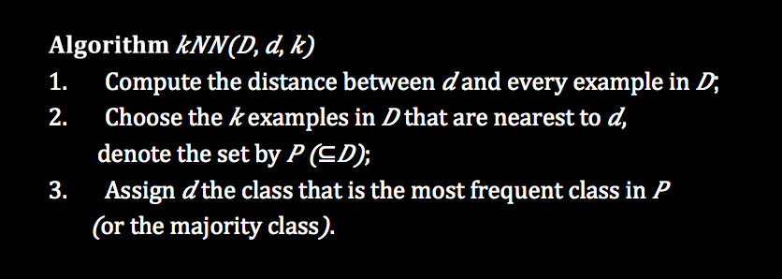
The kNN algorithm

Slide 35
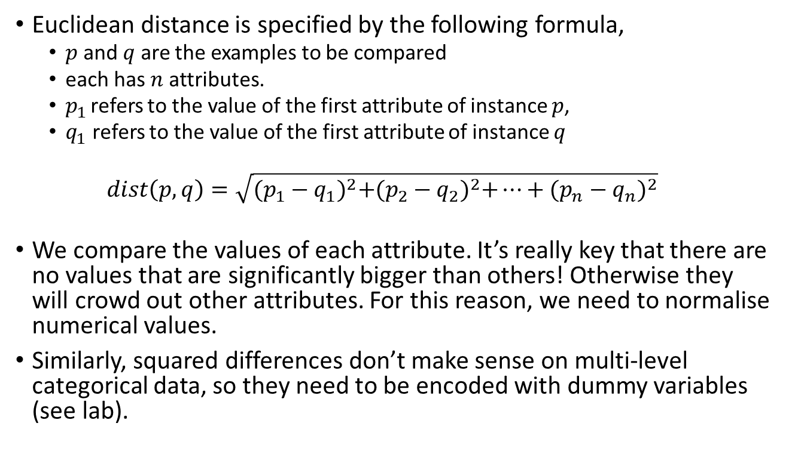
The kNN Algorithm – Distance
Euclidean distance is specified by the following formula,
$p$ and $q$ are the examples to be compared
each has $n$ attributes.
$p_{1}$ refers to the value of the first attribute of instance $p$,
$q_{1}$ refers to the value of the first attribute of instance $q$
$$dist\left(p,q\right)=\sqrt{{(p_{1}−q_{1})}^{2}+{(p_{2}−q_{2})}^{2}+…+{(p_{n}−q_{n})}^{2}}$$
We compare the values of each attribute. It’s really key that there are no values that are significantly bigger than others! Otherwise they will crowd out other attributes. For this reason, we need to normalise numerical values.
Similarly, squared differences don’t make sense on multi-level categorical data, so they need to be encoded with dummy variables (see lab).

Slide 36
The kNN Algorithm – selecting k
The BIG question: What should k be?
If we use k = 3 instead, a vote among the three nearest neighbours is needed and the majority determines the prediction.
In the case of a tie, typically random tie breaking is applied.
It’s never obvious what our K should be. So you need to try lots of values!
AND: There IS NOT a single definitive answer as to what k should be!

Slide 37
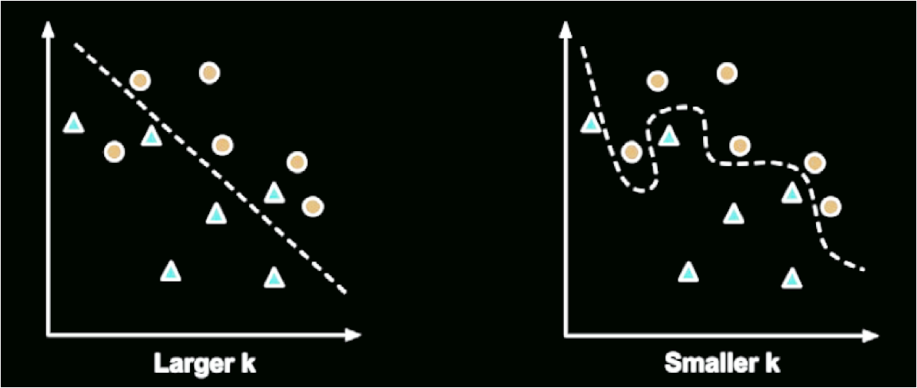
The kNN Algorithm – decision boundary
Smaller values allow more complex decision boundaries that more carefully fit the training data. Too complex, however is not good!
BUT we do not know whether the straight boundary or the curved boundary better represents the true underlying concept to be learned. Hence we need to experiment…

Slide 38
The kNN Algorithm – pragmatically selecting k
In practice, choosing k depends on the difficulty of the concept to be learned and the number of instances in the training data.
Often, k is initially set somewhere between 3 and 10.
A common practice is to set k equal to the square root of the number of training instances or attributes.
May not always result in the single best k.
Alternative approaches:
to test several k values on a variety of test datasets and choose the one that delivers the best classification performance.
Increase the size of the training set: unless the data is very noisy, larger and more representative training datasets can make the choice of k less important
This is because even subtle concepts will have a sufficiently large pool of instances to vote as nearest neighbours.

